Slide 1
Digital Image Processing and Applications 數位影像處理與應用
蔡正發(Cheng-Fa Tsai)教授
Email : cftsai@mail.npust.edu.tw
Office: CM424
Office Hour: (一)78、(二)34

Slide 2
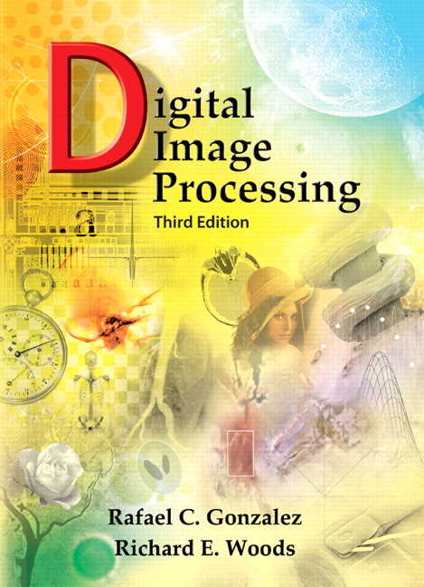
Syllabus
Textbook
Title: Digital Image Processing, Fifth Edition.
Authors: R. C. Gonzalez and R. E. Woods
Publisher: Addison Wesley
Year: 2018

Slide 3
Syllabus
Prerequisite
An interest in Image Processing
Basic Matlab and OpenCV Programming
Course Requirements
Homework Assignments (65%)
Four Program Exercises (4x10=40%)
MidTerm Project (25%)
Midterm Paper Presentation (15 %)
Final Project (20 %)
Final Answer for My raised questions

Slide 4
Syllabus
Homework Submission
Compress all files including programs and image files into a single file (zip or rar).
Rename the file as ID.zip (ex. b10556001.zip)
Upload your file to the ftp site
IP:
User Name:
Password:
Late Policy
Grade = Grade(max{0.2, 1 – 0.2 * delay date});

Slide 5
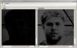
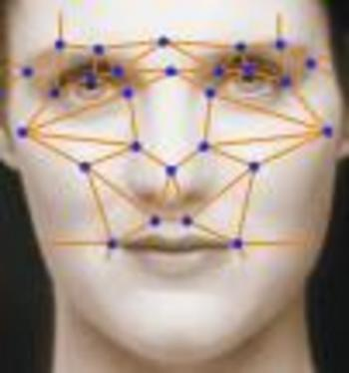
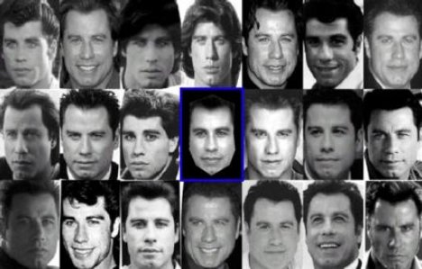
Syllabus
Three Levels in Image Processing
Low-Level Image Processing
Noise Reduction
Image Enhancement
Compression
Mid-Level Image Processing
Segmentation
Representation
High-Level Image Processing
Detection
Recognition
Face Recognition

Slide 6
Digital Image Processing
Chapter 1
Introduction

Slide 7
Contents
Introduction to Digital IP
Fundamental Steps in Digital IP
Components of IP System
Application Fields of Digital IP

Slide 8
Introduction to Digital IP
Why Digital Image Processing (Digital IP)
Improvement of pictorial(圖畫的) information for human interpretation
Processing of image data for storage, transmission, and representation for autonomous (自主的)machine perception(知覺).

Slide 9
Introduction to Digital IP
Journals
International Journal of Computer Vision (IJCV)
IEEE Trans. on Pattern Recognition and Machine Intelligence (PAMI).
IEEE Trans. on Image Processing (IP)
IEEE Trans. on Circuit Systems for Video Technology (CSVT)
Computer Vision and Image Understanding (CVIU)
CVGIP: Graphical Models and Image Processing
……

Slide 10
Introduction to Digital IP
Conference
International Conference on Computer Vision (ICCV)
IEEE Conference on Computer Vision and Pattern Recognition (CVPR)
European Conference on Computer Vision (ECCV)
Asian Conference on Computer Vision (ACCV)
IEEE Conference on Image Processing (ICIP)
IEEE Conference on Pattern Recognition (ICPR)
…….

Slide 11
Introduction to Digital IP
Definition of Digital Image
An image is a continuous 2D function
: spatial coordinate
: intensity or gray level
A digital image is a discrete and limited 2D function
discrete

Slide 12
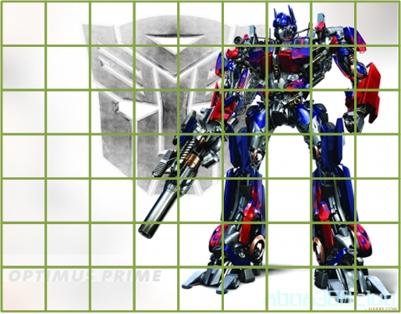
Introduction to Digital IP
Definition of Digital Image
column
row

Slide 13
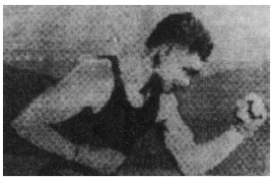
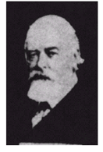
Introduction to Digital IP
Origin
報紙業，於1921年透過
海底電纜，傳送經過編
碼的圖片，以縮短傳送
時間。(紐約-巴黎)
1992由打孔帶編碼所獲得
之數位影像，訊號橫跨兩次大西洋。

Slide 14
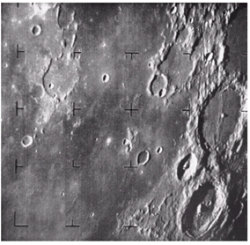
Introduction to Digital IP
Origin
Space Probe
航海者七號於1964年由美國太空船所取得第一張月球照片。

Slide 15
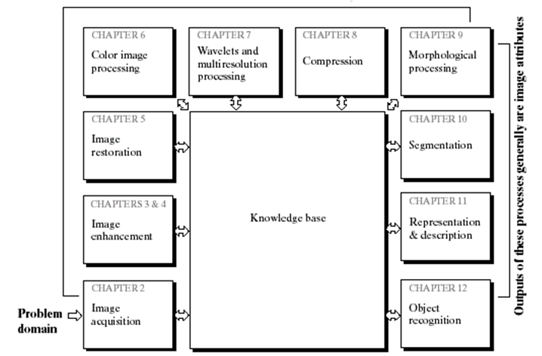
Fundamental Steps in Digital IP
Digital IP Processes

Slide 16
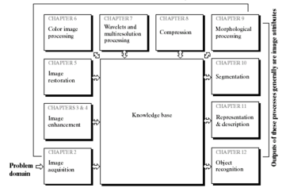
Fundamental Steps in Digital IP
Image Enhancement
Bring out detail or highlight certain features of interest.
Judge the enhancement results according to human subjective preferences.
Image Restoration
Improve the appearance of an image
Judge restoration results according to mathematical or probabilistic models.

Slide 17
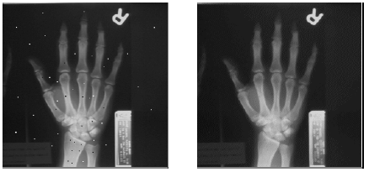
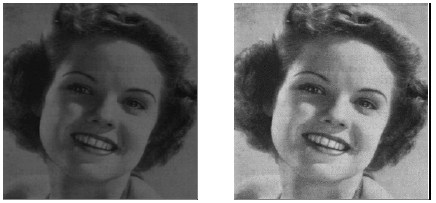
Fundamental Steps in Digital IP
Media Filtering
Histogram Adjustment

Slide 18
Fundamental Steps in Digital IP
Compression
Reduce the storage required to save an image
Reduce the bandwidth required to transmit it
Morphological (形態)Processing
Extract image components useful in the representation and description of shape.
Segmentation
Partition an image into its constituent(構成的) parts of objects

Slide 19
Fundamental Steps in Digital IP
Foreground(前景) Segmentation

Slide 20
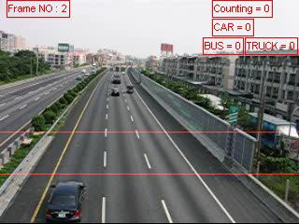
Fundamental Steps in Digital IP
Traffic Monitoring
Detect and track the vehicles in the scene.
Gather statistics of the vehicles passing through the defined area.

Slide 21
Fundamental Steps in Digital IP
Representation & Description
Determine the boundary of region representation.
Extract attributes of interest for differentiating one class of objects from another
Recognition / Detection
Assign a label to an object based on its descriptors.
Knowledge Base
Prior knowledge for guiding the operations of each modules.

Slide 22

Fundamental Steps in Digital IP
Lane/Vehicle Detection
Detect the lane and vehicles in front on the highway under different traffic conditions.

Slide 23
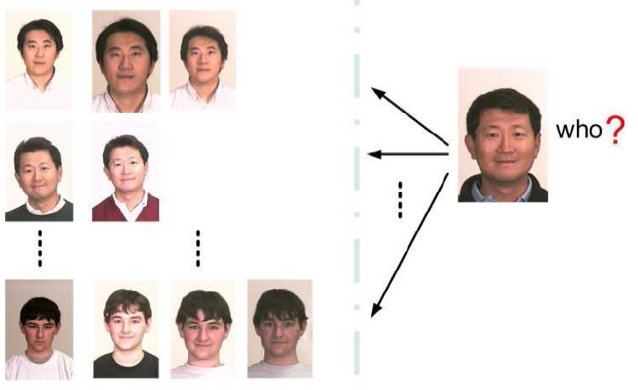
Fundamental Steps in Digital IP
Face Recognition

Slide 24
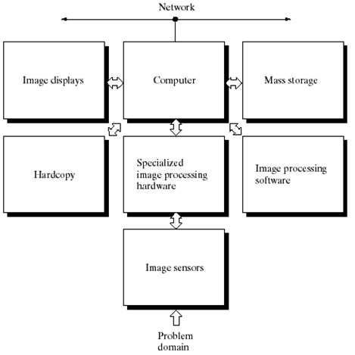
Components of IP System

Slide 25
Components of IP System
Image Sensors
Physical Device: sense the energy radiated by the object we wish to image
Digitizer: convert the output of physical device into digital form.
Specialized Image Processing Hardware
Perform some primitive operations
Perform functions that require fast data throughout

Slide 26
Components of IP System
Computer
It is a general-purpose computer ranging from PC to a supercomputer.
Mass Storage
Provide adequate storage to IP system
Short-Term Storage: for use during processing
On-Line Storage: for relatively fast recall
Archival Storage: for infrequent access.

Slide 27
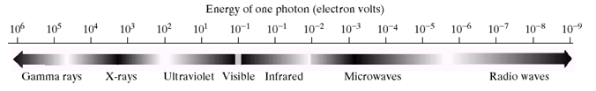
Application Fields of Digital IP
Application Category
Understand the extent of image processing applications.
Categorize images according to their source.
Electromagnetic (EM) energy spectrum電磁能量光譜

Slide 28
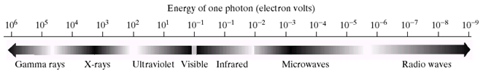
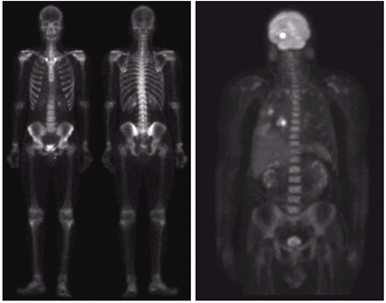
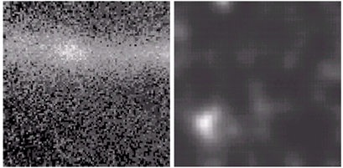
Application Fields of Digital IP
Gamma-Ray Imaging
Nuclear Medicine核子醫學
Astronomical Observations天文的觀察
天鵝座星環
Cygnus star ring
核子反應閥
Nuclear reaction valve
正電子(PET:positron emission tomography)
斷層掃描
骨頭掃描

Slide 29
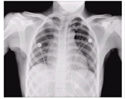
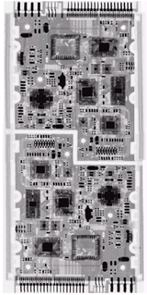
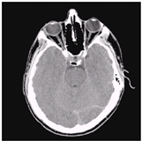
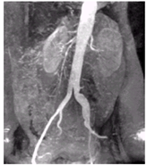
Application Fields of Digital IP
X-ray Imaging
胸部X光chest cchest
頭部
斷層切片
Head fault slices
動脈血管圖Figure arteries
電路板

Slide 30
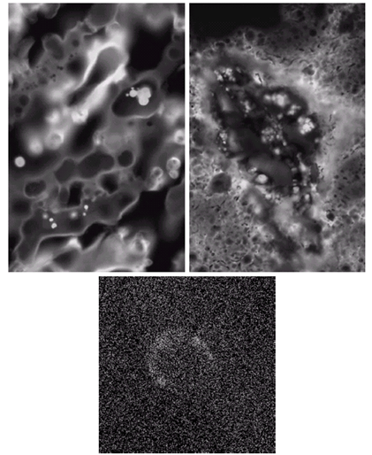
Application Fields of Digital IP
Imaging in the Ultraviolet Band紫外線波段
螢光顯微鏡
正常玉蜀黍normal corn
螢光顯微鏡
染病玉蜀黍infected corn
天鵝座環狀星雲Cygnus Ring Nebula

Slide 31
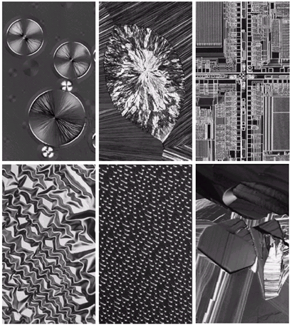
Application Fields of Digital IP
Imaging in the Visible and Infrared(紅外線的波段) Bands
抗癌因子anti-cancer factor
膽固醇cholesterol
微處理機microprocessor
氧化鎳
薄膜Nickel oxide film
CD 表面
有機
超導體organic superconductors

Slide 32
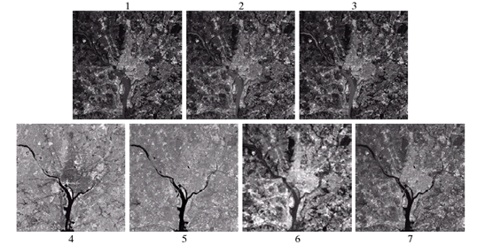
Application Fields of Digital IP
Imaging in the Visible and Infrared Bands(紅外線波段)
Images with different wavelengths
NASA華盛頓空照衛星圖
Visible Blue
Visible Green
Visible Red
Near Infrared
Middle Infrared
Thermal Infrared
Middle Infrared

Slide 33
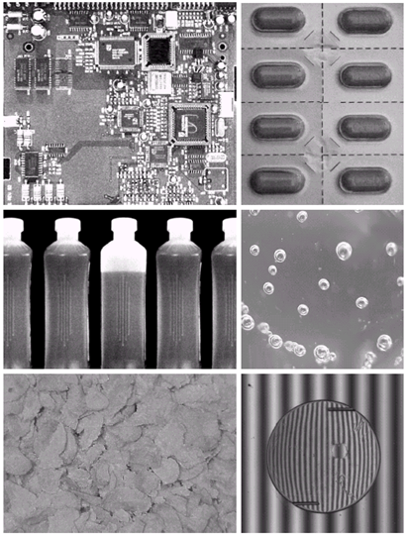
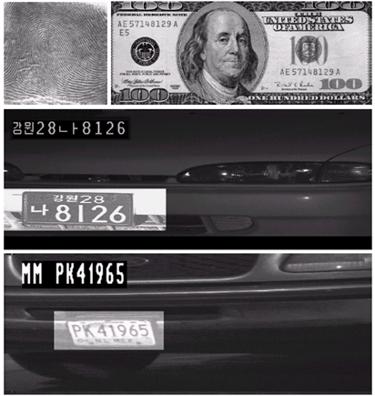
Application Fields of Digital IP
Imaging in the Visible and Infrared Bands
人工眼球
水晶體artificial eye water crystals)

Slide 34
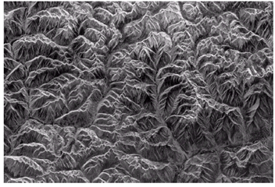
Application Fields of Digital IP
Imaging in the Microwave Band
(NASA太空雷達)
西藏東南方山區

Slide 35
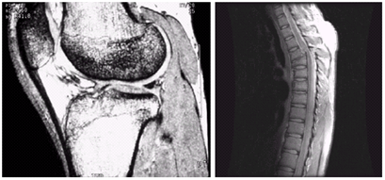
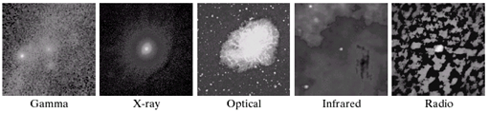
Application Fields of Digital IP
Imaging in the Radio(無線電) Band
膝蓋骨kneecap
脊椎骨vertebra
Magnetic Resonance Imaging (MRI)
磁振造影術
巨蟹星雲Crab nebula

Slide 36
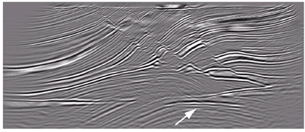
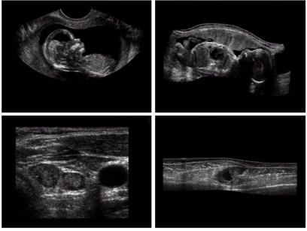
Application Fields of Digital IP
Other Imaging Modalities(形式型態)
超音波成像 (Ultrasound Imaging)
Seismic Imaging (震測影像)
嬰兒baby
嬰兒側視圖baby side view
甲狀軟骨armored cartilage
肌肉層muscle layer

Slide 37
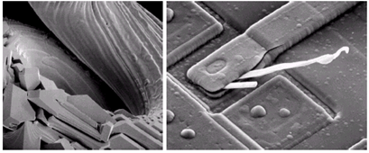
Application Fields of Digital IP
Other Imaging Modalities
燒斷之鎢絲燈燈泡burned tungsten bulb
損壞之積體電路 (2500倍)damaged IC
掃描式電子顯微鏡
(Scanning Electronic Microscope (SEM))

Slide 38
The End!

